Slide 1
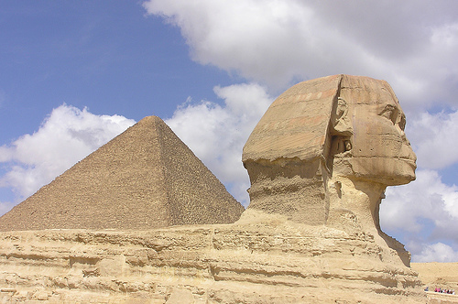
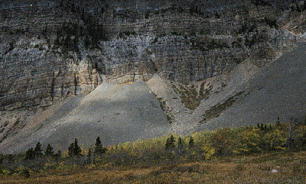
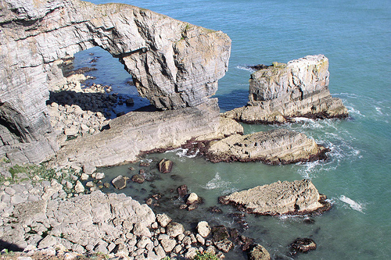
What do the following photos have in common?

Slide 2
They all show geomorphic processes
These processes act continually upon the landscape.
They slowly change the shape and appearance of the landscape.
The three processes are weathering, erosion and mass movement.

Slide 3
Which photo shows which process?
Weathering

Slide 4
Which photo shows which process?
Erosion

Slide 5
Which photo shows which process?
Mass movement

Slide 6
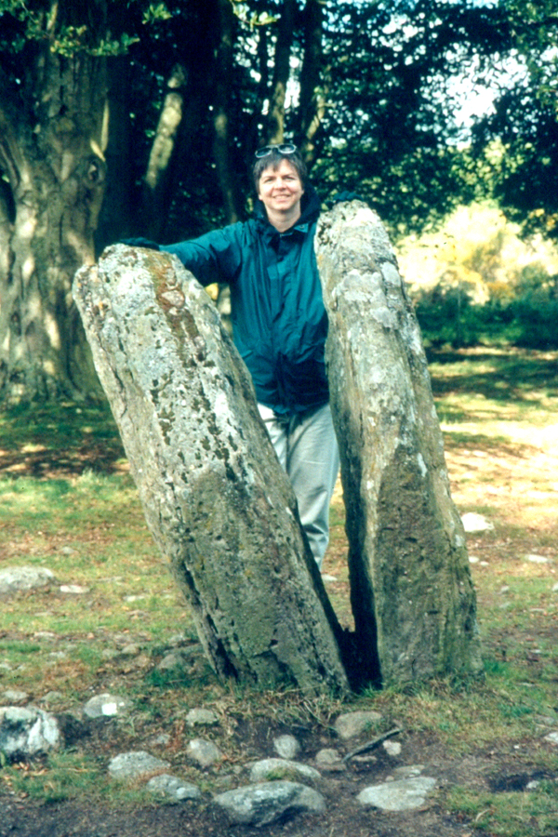
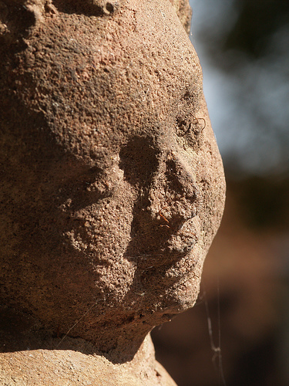
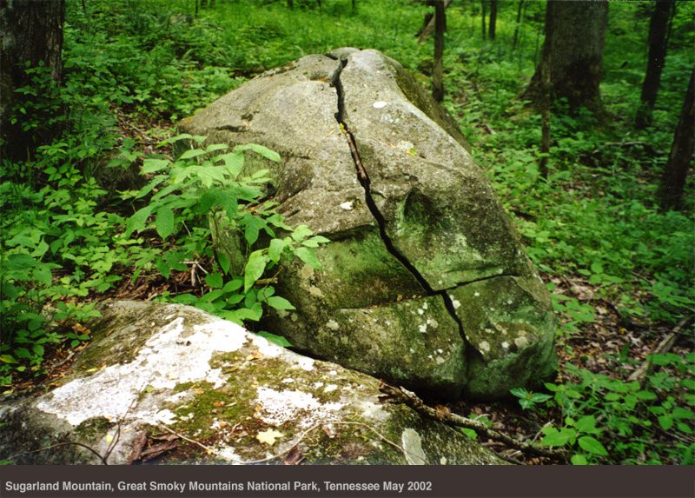
Weathering
It is the breakdown of rock in the place they were found by the action of weather chemicals, plants and animals.

Slide 7
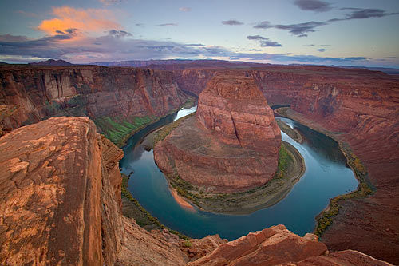
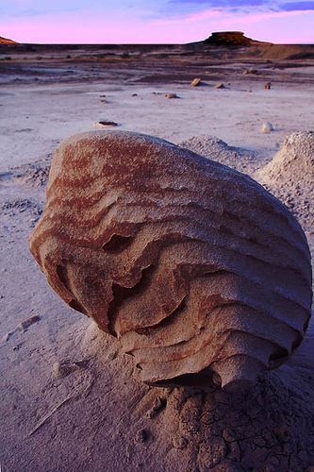
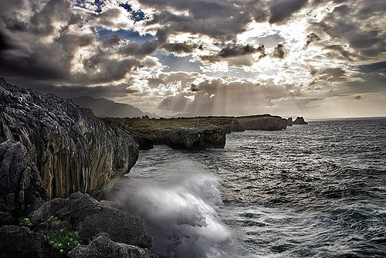
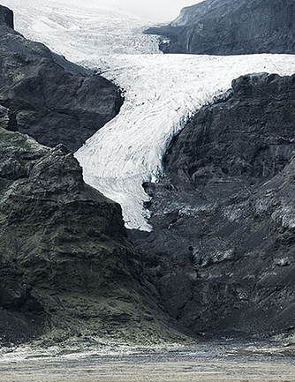
Erosion
Rivers, waves, ice and wind erode rocks and transport the fragments away.

Slide 8
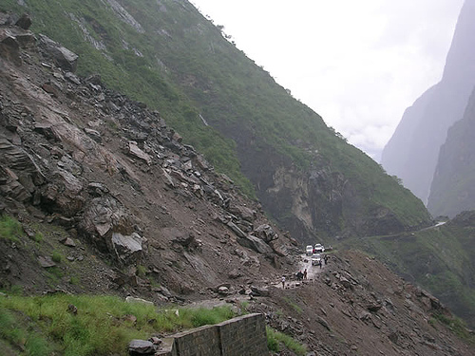
Mass Movement
When rocks, loosened by weathering move downhill under the influence of gravity.

Slide 9
Different types of weathering activity.
Organise yourself into pairs (A and B)
Sit back to back
A’ then describes their diagram which they do not allow their partner to see. ‘B’ has to draw what ‘A’ is describing, aiming to make a perfect replica which is exact in size, shape and detail complete with the labelling.
‘B’ may ask as many questions as they like, and it is A’s job to be as helpful as possible.

Slide 10
Which type of weathering is most likely to…
Occur in a desert climate
Happen in Britain more in the winter than the summer
Happen in Britain more in the summer than winter
Happen fastest in a tropical rainforest
Effect statues

